Slide 1

Test Automation

Slide 2
Automation Testing
Use of software tools to execute pre-scripted tests on an application automatically
Validates functionality, performance, and reliability without manual intervention
Ideal for repetitive, data-driven, and regression testing

Slide 3
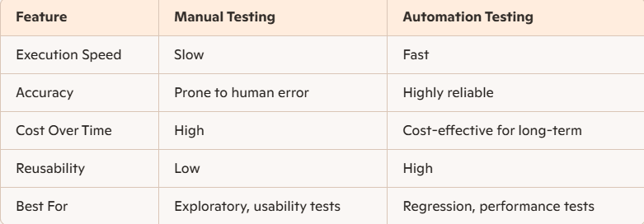
Objectives of Automation Testing
Improve test efficiency and accuracy
Enable faster feedback during development
Enhance test coverage across platforms and configurations
Reduce manual effort and human error

Slide 4
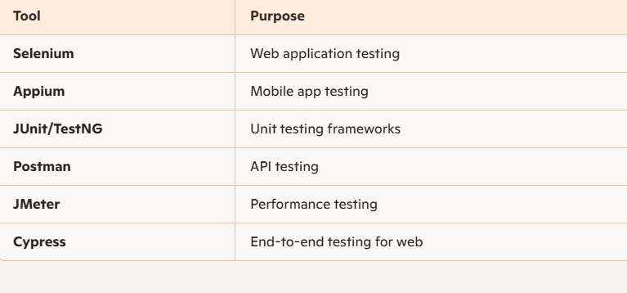
Tools for Automation

Slide 5
When to Automate
Tests that are repetitive and stable
Regression suites for frequent builds
Data-driven tests with large input sets
Smoke tests for quick validation
Performance and load tests that require simulation

Slide 6
Selenium
Selenium is an open-source automation tool for testing web applications
Supports multiple browsers, operating systems, and programming languages
Enables automated functional testing across platforms
Main Focus on Web browser Automation

Slide 7
Why Selenium?
Cross-browser support: Chrome, Firefox, Safari, Edge
Multi-language support: Java, Python, C#, Ruby, JavaScript
Platform independence: Windows, macOS, Linux
Integration: Works with TestNG, JUnit, Jenkins, Maven, CI/CD tools
Open source & extensible: Resources and forums for support

Slide 8
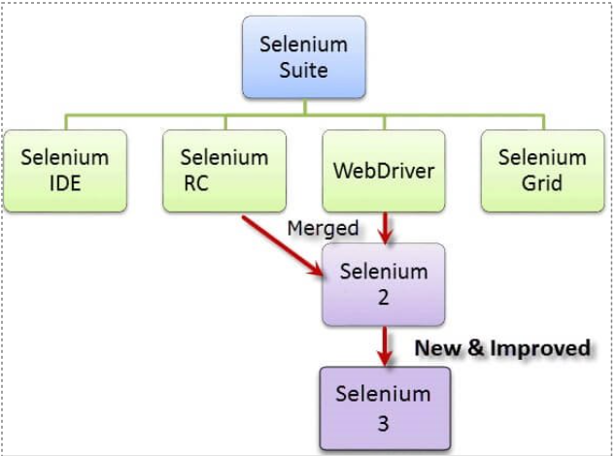
Evolution of Selenium

Slide 9
2004 – Selenium Core (Original Selenium)​
Invented by: Jason Huggins at ThoughtWorks.​
Purpose: Automated testing of web applications using JavaScript.​
How it worked: Injected JavaScript into the browser to simulate user actions.​
Limitation: Same-Origin Policy restrictions — couldn’t access elements from different domains.​
​
🔸 2005 – Selenium RC (Remote Control)​
Improved by: Paul Hammant (ThoughtWorks).​
What it introduced: A proxy server to overcome Same-Origin Policy.​
Key Feature: Allowed writing test scripts in multiple languages: Java, C#, Python, PHP, etc.​
Limitation: Slower execution due to the proxy layer.​
​
🔸 2006 – Selenium IDE​
Created by: Shinya Kasatani (Japan).​
Type: Firefox/Chrome browser extension.​
Purpose: Record-and-playback tool for test scripts.​
Ideal For: Beginners and quick test creation.​
Limitation: Limited to Firefox/Chrome and not suitable for complex test cases.​

Slide 10
2008 – Selenium WebDriver​
Led by: Simon Stewart (Google).​
Major Breakthrough: Directly controls browser using native automation libraries.​
Advantage: No proxy required; faster, more stable tests.​
Supported Browsers: Chrome, Firefox, Edge, Safari, Opera, etc.​
Became Industry Standard and replaced Selenium RC.​
​
🔸 2011 – Selenium 2.0​
Merge of: Selenium WebDriver + Selenium RC.​
RC officially deprecated.​
WebDriver became the core API.​
Improved support for dynamic content, AJAX, modern web apps.​
​
🔸 2016 – Selenium 3.0​
Enhancements:​
Fully removed Selenium RC​
Focus on stability and browser compatibility​
Introduced W3C WebDriver protocol (early adoption)​
Support for major browsers through their native drivers (like chromedriver, geckodriver)​

Slide 11
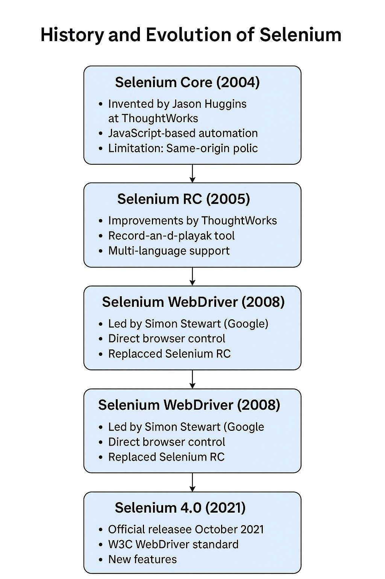
2021 – Selenium 4.0 (Latest Major Version)​
​
Officially released: October 2021​
Key Features:​
Full adoption of W3C WebDriver standard​
Improved Selenium Grid 4 with Docker and distributed architecture​
Relative Locators (e.g., above(), below(), near())​
DevTools integration (for network interception,performance monitoring)​
Better support for modern browsers and parallelexecution​
Selenium IDE was revamped and re-released​

Slide 12
Components of Selenium
Selenium IDE
Integrated Development Environment for Selenium scripts
Firefox/Chrome plugin for recording and playback
Ideal for beginners and exploratory testing
Supports exporting scripts to various languages
Selenium Remote Control (RC)
Allows writing tests in multiple languages
Uses a server as a middle layer between test scripts and browser
Now deprecated in favor of WebDriver
Useful for legacy systems and historical context

Slide 13
Components of Selenium
Selenium WebDriver
Directly communicates with browsers using native APIs
Supports Java, Python, C#, Ruby, JavaScript
More robust and faster than RC
Backbone of modern Selenium automation frameworks
Selenium Grid
Enables distributed test execution
Runs tests in parallel across multiple machines and browsers
Ideal for cross-browser and cross-platform testing
Reduces overall test execution time

Slide 14
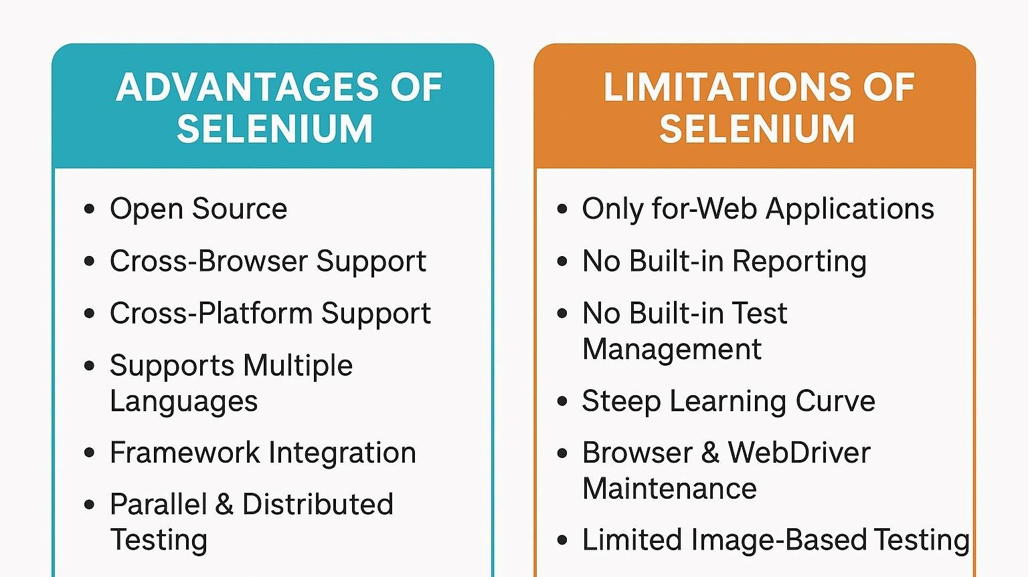

Slide 15
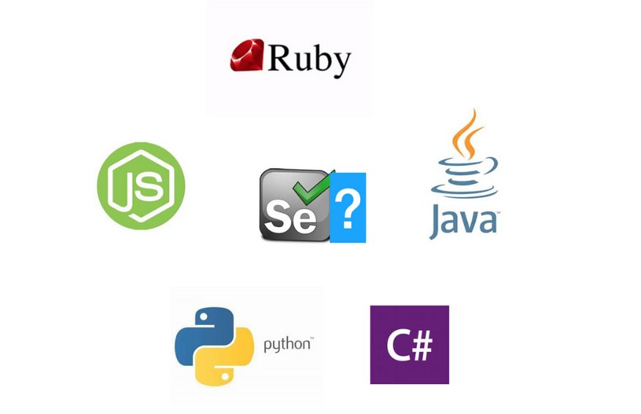
Selenium Supported Languages

Slide 16
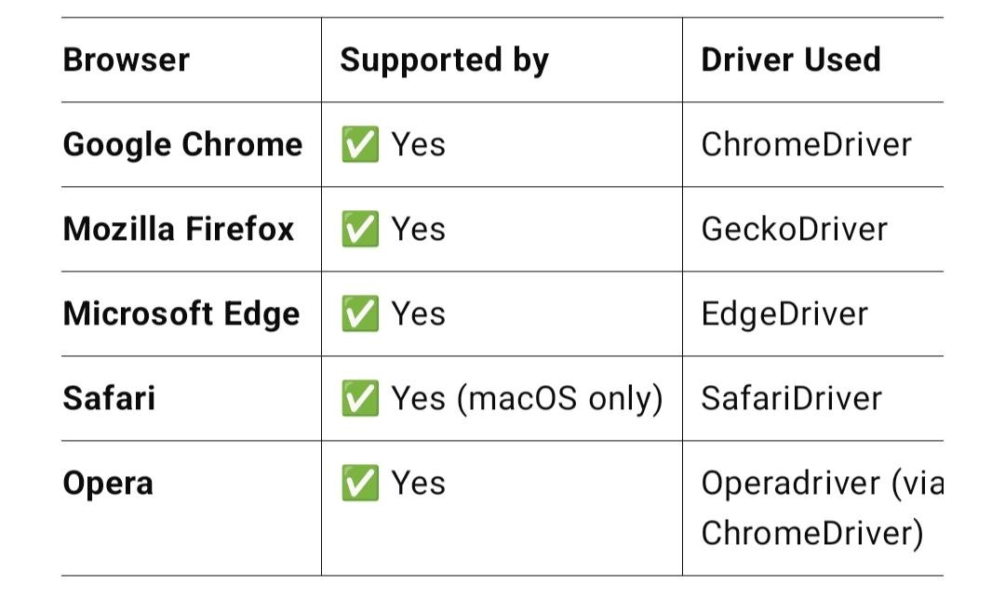
Cross Browser Compatibility

Slide 17
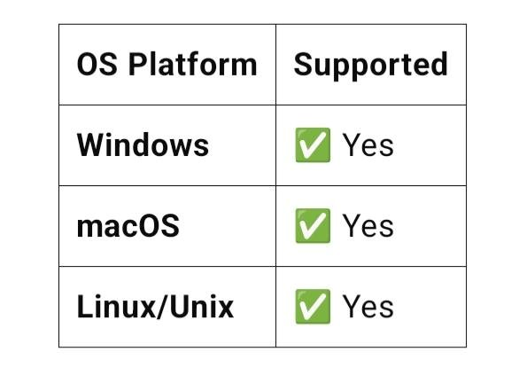
Cross Platform Compatibility

Slide 18
Selenium WebDriver
an open-source API used to automate web browser interactions by communicating directly with the browser.
Supports multiple programming languages and cross-browser testing
Integrates with CI/CD tools like Jenkins, GitHub Actions
Works with testing frameworks like TestNG, JUnit, PyTest

Slide 19
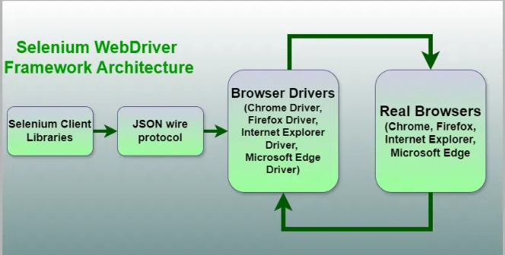
How Selenium WebDriver works
Test script is written using Selenium Client Libraries.
Commands are sent via HTTP requests (JSON Wire Protocol/W3C WebDriver Protocol) to the appropriate Browser Driver.
The Browser Driver communicates with the Browser, performs the requested action, and sends the response back.
The Client Library receives the response and proceeds with the next command in the script.

Slide 20

Setting Up Eclipse, JDK, and Selenium Webdriver
Java Development Kit (JDK)
Download and install the Java SE Development Kit (JDK)
Set the JAVA_HOME in your System Environment variables
Verify with the command java -version​ in command prompt
Eclipse IDE
Go to: https://www.eclipse.org/downloads/​
Download Eclipse IDE for Java Developers​
Install and launch Eclipse.

Slide 21
Setting up Eclipse, Selenium Webdriver
ChromeDriver
Download ChromeDriver from https://sites.google.com/chromium.org/driver/​
Download the version that supports your chrome browser version
Maven
Download and install maven https://maven.apache.org/download.cgi
Extract it to a directory like C:\Program Files\Apache\Maven
Set Environment variable MAVEN_HOME as C:\Program Files\Apache\Maven and path as %MAVEN_HOME%\bin
Verify installation with command mvn –version in cmd
Download maven plugin in eclipse marketplace

Slide 22
Create Your First Selenium Project
Open
Open Eclipse
Go
Go to File > New > Project
Select
Select Maven Project > Click Next > Next
Select
Select the archetype maven-archetype-quickstart
Enter
Enter Group ID as com.selenium.project
Enter
Enter Artifact ID as selenium-practice
Click
Click Finish

Slide 23
Give y in console to complete the build
Now add the required dependencies
<dependency>
<groupId>org.seleniumhq.selenium</groupId>
<artifactId>selenium-java</artifactId>
<version>4.33.0</version>
</dependency>

Slide 24
WebDriver API Methods
Browser Control Methods
Method | Description | Example
get(String url) | Opens a webpage | driver.get("https://example.com");
getTitle() | Returns page title | String title = driver.getTitle();
getCurrentUrl() | Returns current URL | String url = driver.getCurrentUrl();
getPageSource() | Returns HTML source | String source = driver.getPageSource();
close() | Closes current tab | driver.close();
quit() | Closes all tabs and ends session | driver.quit();

Slide 25
Browser Window Methods
Method | Description | Example
maximize() | Maximizes the browser window | driver.manage().window().maximize();
minimize() | Minimizes the browser window | driver.manage().window().minimize();
fullscreen() | Sets the window to fullscreen mode | driver.manage().window().fullscreen();
getSize() | Gets window dimensions | driver.manage().window().getSize();
setSize(Dimension) | Sets window size | driver.manage().window().setSize(new Dimension(1024,768));
getPosition() | Gets window position | driver.manage().window().getPosition();
setPosition(Point) | Sets window position | driver.manage().window().setPosition(new Point(100,100));

Slide 26
Navigation Methods
Method | Description | Example
navigate().to(url) | Navigates to a URL | driver.navigate().to("https://google.com");
navigate().back() | Goes back in browser history | driver.navigate().back();
navigate().forward() | Goes forward in browser history | driver.navigate().forward();
navigate().refresh() | Refreshes the current page | driver.navigate().refresh();

Slide 27
WebElement Interaction Methods
Method | Description | Example
findElement(By) | Finds a single element | WebElement btn = driver.findElement(By.id("submit"));
findElements(By) | Finds multiple elements | List<WebElement> links = driver.findElements(By.tagName("a"));
click() | Clicks an element | btn.click();
sendKeys("text") | Types into input field | input.sendKeys("hello");
clear() | Clears input field | input.clear();
getText() | Gets visible text | String label = element.getText();
getAttribute("name") | Gets attribute value | String val = element.getAttribute("href");
getCssValue("property") | Gets CSS property value | String color = element.getCssValue("color");
isDisplayed() | Checks visibility | boolean visible = element.isDisplayed();
isEnabled() | Checks if enabled | boolean enabled = element.isEnabled();
isSelected() | Checks if selected (radio/checkbox) | boolean selected = checkbox.isSelected();

Slide 28
Window & Frame Handling Methods
Method | Description | Example
getWindowHandle() | Gets current window ID | String winID = driver.getWindowHandle();
getWindowHandles() | Gets all window IDs | Set<String> allWins = driver.getWindowHandles();
switchTo().window(id) | Switches to another window | driver.switchTo().window(winID);
switchTo().frame(name) | Switches to a frame | driver.switchTo().frame("frame1");
switchTo().defaultContent() | Returns to main page | driver.switchTo().defaultContent();

Slide 29
Locators in Selenium
Locators are strategies used to identify web elements on a page
Essential for interacting with elements like buttons, text fields, links, etc.
Used with findElement() and findElements() methods in Selenium WebDriver.

Slide 30
Types of Selenium Locators
Locator Type | Description | Example Usage
ID | Uses element’s unique ID | By.id("username")
Name | Uses element’s name attribute | By.name("email")
Class Name | Uses CSS class name | By.className("btn-primary")
Tag Name | Uses HTML tag | By.tagName("input")
Link Text | Matches exact link text | By.linkText("Sign In")
Partial Link Text | Matches partial link text | By.partialLinkText("Sign")
CSS Selector | Uses CSS syntax to locate elements | By.cssSelector("input[type='text']")
XPath | Uses XML path expressions | By.xpath("//input[@id='username']")

Slide 31
Which Locators to Use
Priority | Locator Type | Why It's Preferred
1 | ID | Fastest and most reliable (unique per element)
2 | Name | Useful for form fields; often unique
3 | Class Name | Good if class is unique; avoid multiple classes
4 | Link Text | Ideal for hyperlinks with static text
5 | CSS Selector | Flexible and fast; great for styling-based selection
6 | XPath | Powerful but slower; fragile if DOM changes

Slide 32


Slide 33

Locators - XPATH
Xpath – XML Path Language
A query language used for selecting nodes from an XML or HTML document
used to locate elements on a web page based on their attributes, text, or position in the DOM
Types of Xpath:
  Absolute Xpath - Starts from the root node (html) and goes down step-by-step
  Ex: /html/body/div[1]/form/input[1]​
  Relative Xpath - Starts from anywhere in the DOM
  Ex: //tagname[@attribute='value’]
  ​Relative Xpath preferred over Absolute Xpath

Slide 34
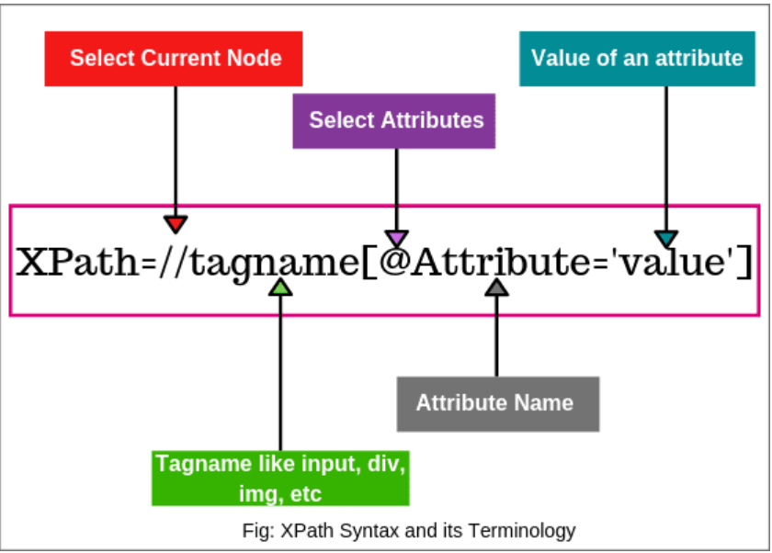
Xpath Syntax

Slide 35
XPath Components
Component | Meaning | Example | Description
/ | Root node | /html/body/div | Absolute path from root
// | Anywhere in document | //input | Finds all <input> elements
. | Current node | . | Refers to current node
.. | Parent node | ./.. | Moves up one level
@ | Attribute | //@href | Selects all href attributes
Basic Syntax Components

Slide 36
Predicates (Filters)
Used inside square brackets [] to refine selections
Predicate | Example | Description
[n] | //li[3] | Third <li> element
[last()] | //div[last()] | Last <div> element
[@id='login'] | //input[@id='login'] | Element with specific attribute
[contains(@class, 'active')] | //div[contains(@class, 'active')] | Partial match
[not(@type='hidden')] | //input[not(@type='hidden')] | Excludes hidden inputs

Slide 37
Functions
XPath includes built-in functions to manipulate strings, positions, and values
Function | Example | Purpose
text() | //p[text()='Hello'] | Matches exact text
contains() | //div[contains(@class, 'note')] | Partial match
starts-with() | //a[starts-with(@href, 'http')] | Prefix match
normalize-space() | //td[normalize-space(text())='Clean'] | Trims whitespace
position() | //li[position()=2] | Selects by position
count() | count(//div) | Counts nodes

Slide 38
Axes (DOM Navigation)
Axes define relationships between nodes
Axis | Example | Description
child:: | //div/child::p | Direct children
parent:: | //span/parent::div | Parent node
ancestor:: | //span/ancestor::div | All ancestors
descendant:: | //div/descendant::p | All descendants
following:: | //h2/following::p | All nodes after <h2>
preceding:: | //h2/preceding::p | All nodes before <h2>
following-sibling:: | //h2/following-sibling::div | Sibling <div> after <h2>
preceding-sibling:: | //h2/preceding-sibling::div | Sibling <div> before <h2>

Slide 39
Wildcards and Node Types
Symbol | Example | Meaning
* | //* | Any element
@* | //@* | Any attribute
node() | //div/node() | Any node type (text, element, comment)

Slide 40
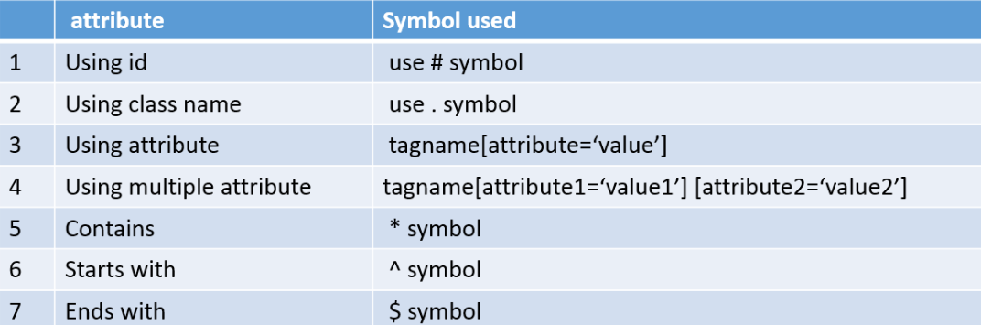
Locating Web Elements using CSS Selector
CSS Selectors provide a fast and efficient way to identify and interact with web elements, making them a preferred choice for automation testing frameworks like Selenium
offer cleaner and more readable expressions to locate elements precisely

Slide 41
Basic CSS Selectors
Selector Type | Syntax Example | Java Selenium Example
ID Selector | #loginBtn | By.cssSelector("#loginBtn")
Class Selector | .form-control | By.cssSelector(".form-control")
Tag Selector | input | By.cssSelector("input")
Attribute Selector | input[name='username'] | By.cssSelector("input[name='username']")

Slide 42
Substring Matching Selectors
Type | Syntax | Example
Starts With | [attribute^='value'] | input[id^='user_']
Ends With | [attribute$='value'] | img[src$='.png']
Contains | [attribute*='value'] | a[href*='login']

Slide 43
Relational Selectors
Type | Syntax | Example
Child Selector | div > p | By.cssSelector("div > p")
Descendant | div p | By.cssSelector("div p")
Adjacent Sibling | h1 + p | By.cssSelector("h1 + p")
General Sibling | h1 ~ p | By.cssSelector("h1 ~ p")

Slide 44
Other Selectors
Type | Syntax | Example
Negation | input:not([type='submit']) | By.cssSelector("input:not([type='submit'])")
Nth Child | li:nth-child(2) | By.cssSelector("li:nth-child(2)")
Nth-of-Type | p:nth-of-type(3) | By.cssSelector("p:nth-of-type(3)")

Slide 45
Locating using multiple selectors
Tag | Selector
<input type="text" name="username" class="form-control"> | By.cssSelector("input.form-control[name='username']")
<input type="password" name="password" class="form-control"> | By.cssSelector("input.form-control[name='password']")
<button type="submit" class="btn-primary">Login</button> | By.cssSelector("button.btn-primary[type='submit']")

Slide 46
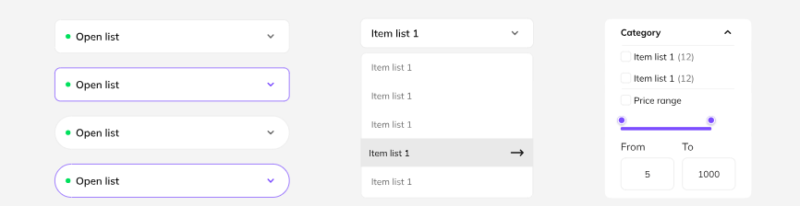
Handling Dropdowns in Selenium
Types of Dropdowns:
  Standard HTML <select> dropdowns
  Custom dropdowns built with <ul>, <div>, etc.
Importance: Common in forms, filters, and navigation menus

Slide 47
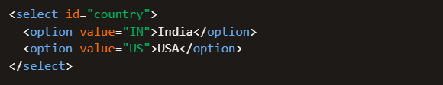
Standard HTML Dropdowns
We make use of Select Class in Selenium
WebElement dropdown= driver.findElement(By.id("country"));
Select select = new Select(dropdown);

Slide 48
Method Name | Description | Syntax Example
selectByVisibleText() | Selects option by the text visible to the user. | select.selectByVisibleText("India");
selectByValue() | Selects option by the value of the value attribute. | select.selectByValue("IN");
selectByIndex() | Selects option by its index (starting from 0). | select.selectByIndex(2);
getOptions() | Returns all options in the dropdown as a list. | List<WebElement> options = select.getOptions();
getFirstSelectedOption() | Returns the first selected option. | WebElement selected = select.getFirstSelectedOption();
getAllSelectedOptions() | Returns all selected options (for multi-select dropdowns). | List<WebElement> selected = select.getAllSelectedOptions();
isMultiple() | Checks if the dropdown allows multiple selections. | boolean multi = select.isMultiple();
deselectByVisibleText() | Deselects option by visible text (multi-select only). | select.deselectByVisibleText("India");
deselectByValue() | Deselects option by value (multi-select only). | select.deselectByValue("IN");
deselectByIndex() | Deselects option by index (multi-select only). | select.deselectByIndex(2);
deselectAll() | Deselects all selected options (multi-select only). | select.deselectAll();

Slide 49
Handling Custom Dropdowns
By storing all the options in List and iterating through it
By creating Custom Locator and without iterating the List
By using JavaScriptExecutor class
By using sendKeys
By using Actions Class

Slide 50

Using JavaScriptExecutor
WebDriver driver;
WebDriver driver = new ChromeDriver();
driver.get("https://www.bstackdemo.com/");
WebElement dd = driver.findElement(By.xpath("//select"));
JavascriptExecutor js = (JavascriptExecutor) driver;
js.executeScript("arguments[0].value='highestprice'", dd);
Using sendKeys
WebDriver driver;
WebDriver driver = new ChromeDriver();
driver.get("https://www.bstackdemo.com/");
driver.findElement(By.xpath("//select")).sendKeys("highestprice");

Slide 51
Using Actions Class
WebDriver driver;
WebDriver driver = new ChromeDriver();
driver.get("https://www.browserstack.com/");
WebElement dd = driver.findElement(By.xpath("//span[@class='nav_item_name' and contains(text(), 'Developers')]"));
Actions action=new Actions(driver);
action.moveToElement(dd).perform();
String option="Support";
WebElement customOption=driver.findElement(By.xpath("//li[@class='developers-menu-control']/a[contains(text(), '"+option+"')]"));
customOption.click();

Slide 52
JavaScriptExecutor
An interface in Selenium WebDriver
Allows execution of JavaScript code within the browser
Perform actions not supported by WebDriver directly
Handle dynamic content and asynchronous behavior
When to Use JavaScriptExecutor:
  Clicking elements not interactable via WebDriver
  Scrolling to specific elements
  Fetching page properties (title, URL, domain)
  Generating alerts or pop-ups
  Refreshing the browser
  Handling Shadow DOM or AJAX-loaded content

Slide 53
JavaScriptExecutor Syntax & Methods
JavascriptExecutor js = (JavascriptExecutor) driver;​
js.executeScript("your JavaScript code here", arguments);​
Use Case​ | JavaScript Code​
Click an element (when normal click fails)​ | js.executeScript("arguments[0].click();",element);​
Scroll to Element​ | js.executeScript("arguments[0].scrollIntoView(true);",element);​
Scroll down by pixels​ | js.executeScript("window.scrollBy(0,500);");​
Set value in a field​ | js.executeScript("arguments[0].value='text';", element);​
Get page title​ | String title = js.executeScript("return document.title;").toString();​
Highlight an element​ | js.executeScript("arguments[0].style.border='3px solid red'",element);​
Refresh the page​ | js.executeScript("history.go(0);");​

Slide 54
When to Use
Use when:
When traditional Selenium commands fail (e.g., hidden elements, custom controls)​
To bypass synchronization issues or improve stability​
For operations that require DOM manipulation​
Note:
Avoid overusing JavaScriptExecutor — it bypasses Selenium’s native event firing and may not mimic real user interactions fully

Slide 55
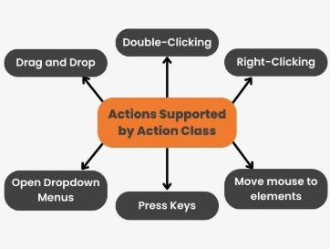
Actions Class
class in Selenium WebDriver for handling complex user gestures
Simulates real-world interactions like drag-and-drop, hover, key presses, etc.
Useful when standard WebDriver methods (like click(), sendKeys()) are insufficient
Can Perform Mouse and Keyboard Actions in Selenium using the Actions class, which simulates advanced user interactions.

Slide 56
Actions Class Methods – Mouse operations
Method | Description | Example
click() | Clicks at current mouse location | actions.click().build().perform();
click(WebElement) | Clicks on a specific element | actions.click(element).build().perform();
doubleClick() | Double-clicks at current location | actions.doubleClick().build().perform();
doubleClick(WebElement) | Double-clicks on a specific element | actions.doubleClick(element).build().perform();
contextClick() | Right-click at current location | actions.contextClick().build().perform();
contextClick(WebElement) | Right-click on a specific element | actions.contextClick(element).build().perform();
moveToElement(WebElement) | Moves mouse to center of element | actions.moveToElement(element).build().perform();
moveToElement(WebElement, x, y) | Moves mouse to offset from element | actions.moveToElement(element, 10, 20).build().perform();
clickAndHold() | Clicks and holds mouse button | actions.clickAndHold().build().perform();
clickAndHold(WebElement) | Clicks and holds on element | actions.clickAndHold(element).build().perform();
release() | Releases mouse button | actions.release().build().perform();
release(WebElement) | Releases mouse on element | actions.release(element).build().perform();
dragAndDrop(source, target) | Drags source and drops on target | actions.dragAndDrop(source, target).build().perform();
dragAndDropBy(source, x, y) | Drags source by offset | actions.dragAndDropBy(source, 50, 100).build().perform();
moveByOffset(x, y) | Moves mouse by offset | actions.moveByOffset(30, 40).build().perform();

Slide 57
Actions Class Methods – Keyboard Operations
Method | Description | Example
sendKeys(CharSequence...) | Sends keys to active element | actions.sendKeys("Hello").build().perform();
sendKeys(WebElement, CharSequence...) | Sends keys to specific element | actions.sendKeys(inputField, "Selenium").build().perform();
keyDown(CharSequence key) | Presses modifier key | actions.keyDown(Keys.SHIFT).build().perform();
keyDown(WebElement, CharSequence key) | Presses key on element | actions.keyDown(inputField, Keys.CONTROL).build().perform();
keyUp(CharSequence key) | Releases modifier key | actions.keyUp(Keys.SHIFT).build().perform();
keyUp(WebElement, CharSequence key) | Releases key on element | actions.keyUp(inputField, Keys.CONTROL).build().perform();

Slide 58
Drag and Drop Actions in Selenium
Two ways to perform this operation:
1. Actions Method
// Locate the source and target elements​
WebElement source = driver.findElement(By.id("draggable"));​
WebElement target = driver.findElement(By.id("droppable"));​
​
// Create Actions instance​
Actions actions = new Actions(driver);​
​
// Perform drag and drop​
actions.dragAndDrop(source, target).perform();​

Slide 59
Drag and Drop Actions in Selenium
2. Perform Actions manually with click, hold and release
Actions actions = new Actions(driver);​
actions.clickAndHold(source)​
.moveToElement(target)​
.release()​
.build()​
.perform();​

Slide 60
Handling Checkboxes in Selenium
Use Click and isSelected() Methods
WebElement checkbox = driver.findElement(By.id("subscribeCheckbox"));​
​
if (!checkbox.isSelected()) {​
checkbox.click();​
}​
if (checkbox.isSelected()) {​
checkbox.click();​
}​
​
boolean isChecked = checkbox.isSelected();​
System.out.println("Checkbox selected: " + isChecked)

Slide 61
Handling Multiple Checkboxes
If checkboxes have a common attribute (e.g., name='skills’):​
List checkboxes = driver.findElements(By.name("skills"));​
​
for (WebElement box : checkboxes) {​
if (box.getAttribute("value").equals("Java")) {​
if (!box.isSelected()) {​
box.click();​
}​
}​
}​

Slide 62
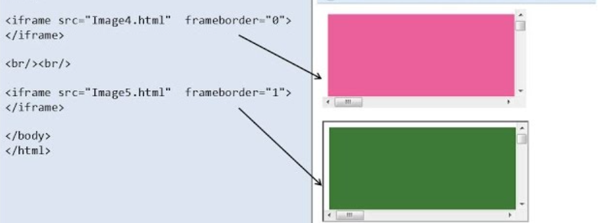
Handling Frames in Selenium
Frame: An HTML element that divides a page into sections, each loading a separate document
iFrame (Inline Frame): Embeds another HTML document within the current one.
Use Cases: Embedded videos, ads, login forms, widgets.

Slide 63

Why handle frames
Selenium interacts with the DOM
Elements inside frames are not accessible until you switch context
Failure to switch results in NoSuchElementException

Slide 64
Switching to Frame in Selenium
Method | Description | Example Code
frame(int index) | Switches to a frame by its zero-based index. Useful when no ID or name exists. | driver.switchTo().frame(0);
frame(String nameOrId) | Switches to a frame using its name or ID attribute. | driver.switchTo().frame("loginFrame");
frame(WebElement frameElement) | Switches to a frame using a WebElement reference. | WebElement frame = driver.findElement(By.id("frameId"));driver.switchTo().frame(frame);
parentFrame() | Switches to the parent frame of the current frame. | driver.switchTo().parentFrame();
defaultContent() | Switches back to the main document (top-level page). | driver.switchTo().defaultContent();

Slide 65
Examples
Switching frame by WebElement
WebElement iframe = driver.findElement(By.xpath("//iframe[@id='gfgiframe']"));
driver.switchTo().frame(iframe);
driver.findElement(By.id("Textmessage")).sendKeys("Thanks for the tutorial!");
driver.switchTo().parentFrame();
Switching frame by Index
driver.findElement(By.id("name")).sendKeys("Alice");
driver.switchTo().frame(0); // Switch to first frame
driver.findElement(By.id("message")).sendKeys("Hello from inside the frame!");
driver.switchTo().defaultContent(); // Back to main page
driver.findElement(By.id("submit")).click();

Slide 66
Handling windows in Selenium
Refers to switching between multiple browser windows or tabs during automation
Common in apps with pop-ups, external links, or modal dialogs
Selenium uses window handles to identify and switch between windows.
Window Handle:
  A unique string ID assigned to each browser window/tab
  Retrieved using:
    driver.getWindowHandle() → current window
    driver.getWindowHandles() → all open windows

Slide 67
switchTo().window Methods
Method | Description | Example Code
getWindowHandle() | Gets the current window's unique ID | String parent = driver.getWindowHandle();
getWindowHandles() | Gets all open window IDs as a Set<String> | Set<String> handles = driver.getWindowHandles();
switchTo().window(String handle) | Switches to a specific window/tab using its handle | driver.switchTo().window(childHandle);
close() | Closes the current window | driver.close();
quit() | Closes all windows and ends the WebDriver session | driver.quit();

Slide 68
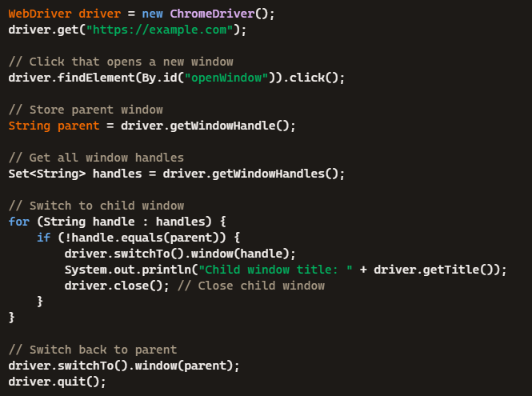
Switching between Windows

Slide 69

Handling Tabs in Selenium

Slide 70
Handling Alerts in Selenium
Alert Type | Description
Simple Alert | Displays a message with an OK button
Confirmation Alert | Asks for confirmation with OK and Cancel
Prompt Alert | Requests user input with a text field and buttons
Alerts are JavaScript popups triggered by web pages
They interrupt normal flow and require user interaction
Selenium must switch context to interact with them

Slide 71
switchTo().alert() methods
Method | Purpose | Example
accept() | Clicks OK on the alert | alert.accept();
dismiss() | Clicks Cancel on the alert | alert.dismiss();
getText() | Retrieves alert message | String msg = alert.getText();
sendKeys(String text) | Sends input to a prompt alert | alert.sendKeys("Hello");

Slide 72
Examples
Handling Simple Alerts
WebDriver driver = new ChromeDriver();
driver.get("https://demoqa.com/alerts");
driver.findElement(By.id("alertButton")).click(); // triggers alert
Alert alert = driver.switchTo().alert();
System.out.println("Alert text: " + alert.getText());
alert.accept(); // clicks OK

Slide 73
Handling Confirmation Alerts
driver.findElement(By.id("confirmButton")).click();
Alert alert = driver.switchTo().alert();
System.out.println("Confirmation text: " + alert.getText());
alert.dismiss(); // clicks Cancel
Handling Prompt Alerts
driver.findElement(By.id("promtButton")).click();
Alert alert = driver.switchTo().alert();
alert.sendKeys("Selenium User");
alert.accept(); // submits input

Slide 74
Waits in Selenium
Wait Type | Description
Implicit Wait | Applies globally to all elements; waits for presence
Explicit Wait | Waits for specific conditions on specific elements
Fluent Wait | Customizable wait with polling and exception handling
Web elements may load at different times due to AJAX or JavaScript
Without waits, Selenium may interact with elements before they’re ready, causing errors
Waits help ensure reliable and stable test execution

Slide 75
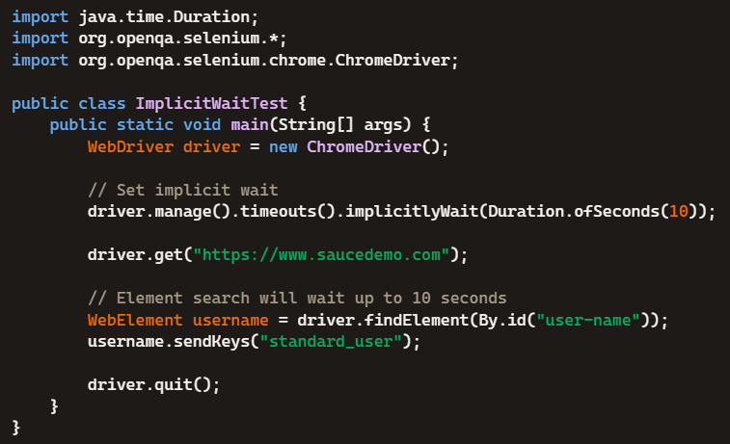
Implicit wait
A global timeout applied to all element searches
Tells WebDriver to wait for a specified time before throwing NoSuchElementException
Helps handle dynamic content and slow-loading elements
Syntax:
  driver.manage().timeouts().implicitlyWait(Duration.ofSeconds(10));

Slide 76
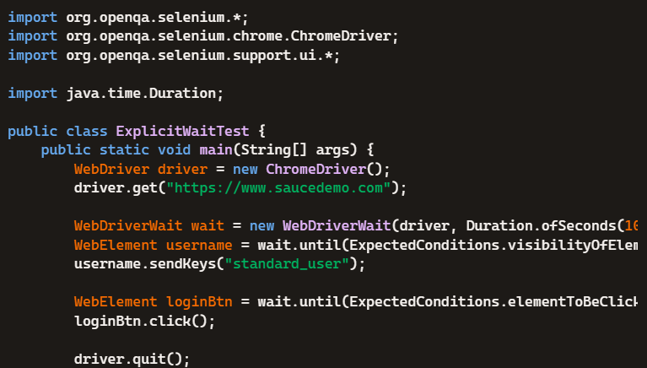
Explicit wait
A targeted wait that pauses execution until a specific condition is met
Used for elements that load dynamically or take time to become clickable, visible, or present
Prevents flaky tests caused by premature interactions

Slide 77
Condition | Description | Example Usage
visibilityOfElementLocated(By locator) | Waits until the element is visible on the page. | wait.until(ExpectedConditions.visibilityOfElementLocated(By.id("username")));
elementToBeClickable(By locator) | Waits until the element is visible and enabled so it can be clicked. | wait.until(ExpectedConditions.elementToBeClickable(By.id("submit")));
presenceOfElementLocated(By locator) | Waits until the element is present in the DOM, regardless of visibility. | wait.until(ExpectedConditions.presenceOfElementLocated(By.name("email")));
textToBePresentInElementLocated(By locator, String text) | Waits until the specified text appears in the element. | wait.until(ExpectedConditions.textToBePresentInElementLocated(By.id("msg"), "Success"));
titleContains(String titleFragment) | Waits until the page title contains the given text. | wait.until(ExpectedConditions.titleContains("Dashboard"));
titleIs(String title) | Waits until the page title exactly matches the given string. | wait.until(ExpectedConditions.titleIs("Login Page"));
urlToBe(String url) | Waits until the current URL matches the expected URL. | wait.until(ExpectedConditions.urlToBe("https://example.com/home"));
alertIsPresent() | Waits until a JavaScript alert is present. | wait.until(ExpectedConditions.alertIsPresent());
frameToBeAvailableAndSwitchToIt(By locator) | Waits until a frame is available, then switches to it. | wait.until(ExpectedConditions.frameToBeAvailableAndSwitchToIt(By.id("frame1")));
invisibilityOfElementLocated(By locator) | Waits until the element is not visible or removed from the DOM. | wait.until(ExpectedConditions.invisibilityOfElementLocated(By.className("loader")));
stalenessOf(WebElement element) | Waits until the element is no longer attached to the DOM. | wait.until(ExpectedConditions.stalenessOf(oldElement));
elementToBeSelected(By locator) | Waits until the element (e.g., checkbox) is selected. | wait.until(ExpectedConditions.elementToBeSelected(By.id("agree")));
numberOfElementsToBe(By locator, int count) | Waits until a specific number of elements are present. | wait.until(ExpectedConditions.numberOfElementsToBe(By.tagName("li"), 5));

Slide 78
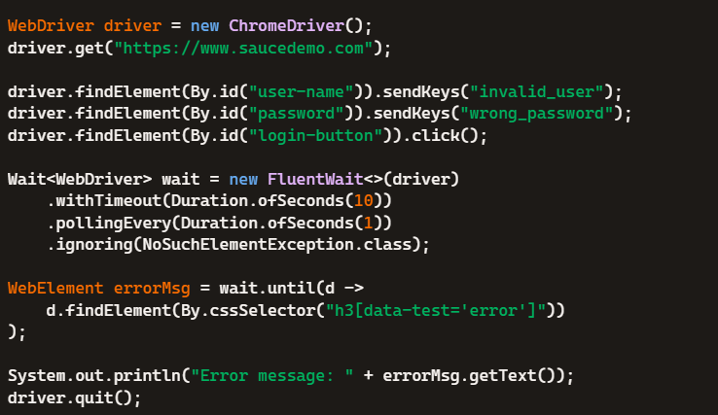
Fluent wait
A type of explicit wait with enhanced flexibility
Ideal for elements that load unpredictably or asynchronously
Allows you to:
  Set maximum timeout
  Define polling frequency
  Ignore exceptions during wait

Slide 79
Fluent Wait Parameters
Parameter | Description
withTimeout() | Sets max wait duration
pollingEvery() | Sets how often condition is checked
ignoring() | Specifies exceptions to ignore during wait
until() | Defines condition to wait for

Slide 80
Cookies Handling in Selenium
Small pieces of data stored by the browser.
Used to remember user sessions, preferences, and authentication.
Why we need to handle cookies:
Maintain user sessions across tests
Avoid repetitive login steps
Test cookie-based features (e.g., personalization, tracking)
Validate cookie behavior (creation, deletion, expiration)

Slide 81
Cookies methods
Method | Description | Example Code
getCookies() | Retrieves all cookies from the current session. | Set<Cookie> cookies = driver.manage().getCookies();
getCookieNamed(String name) | Gets a cookie by its name. | Cookie ck = driver.manage().getCookieNamed("sessionID");
addCookie(Cookie cookie) | Adds a new cookie to the browser session. | driver.manage().addCookie(new Cookie("sessionID", "abc123"));
deleteCookie(Cookie cookie) | Deletes a cookie using the Cookie object. | driver.manage().deleteCookie(ck);
deleteCookieNamed(String name) | Deletes a cookie by its name. | driver.manage().deleteCookieNamed("sessionID");
deleteAllCookies() | Deletes all cookies from the current session. | driver.manage().deleteAllCookies();

Slide 82
Examples
// Open a website​
driver.get("https://example.com");​
​
//Add a new cookie​
Cookie cookie = new Cookie("userSession", "abc123");​
driver.manage().addCookie(cookie);​
​
// Retrieve a cookie by name​
Cookie sessionCookie = driver.manage().getCookieNamed("userSession");​
System.out.println("Cookie Name: " + sessionCookie.getName());​
System.out.println("Cookie Value: " + sessionCookie.getValue());​
// Get all cookies
Set<Cookie> allCookies = driver.manage().getCookies();
for (Cookie c : allCookies) {
System.out.println(c.getName() + " = " + c.getValue());
// Delete a specific cookie
driver.manage().deleteCookieNamed("userSession");
// Delete a specific cookie
driver.manage().deleteCookieNamed("userSession");
// Delete all cookies
driver.manage().deleteAllCookies();

Slide 83
Examples
Reusing Login Cookie to Avoid Login Every Time
// After login
Cookie loginCookie = driver.manage().getCookieNamed("session_id");
// Store it (e.g., in a file or memory), then reuse in next session:
driver.get("https://example.com");
driver.manage().addCookie(loginCookie);
driver.navigate().refresh(); // You’ll be logged in

Slide 84

Taking Screenshots in Selenium
Helps debug failed tests by showing the exact browser state.
Useful for reporting and documentation.
Verifies UI rendering and layout across browsers.
Captures dynamic content during automation.
How to Capture:
  Capture entire viewport using TakesScreenshot
  Capture specific elements (Selenium 4+)
  Capture full-page screenshots using third-party tools like AShot.

Slide 85
Examples
Full Page Screenshot
WebDriver driver = new ChromeDriver();
driver.get("https://example.com");
File src = ((TakesScreenshot) driver).getScreenshotAs(OutputType.FILE);
FileHandler.copy(src, new File("screenshot.png"));
Element Screenshot (Selenium 4+)
WebElement logo = driver.findElement(By.id("site-logo"));
File elementShot = logo.getScreenshotAs(OutputType.FILE);
FileHandler.copy(elementShot, new File("logo.png"));

Slide 86
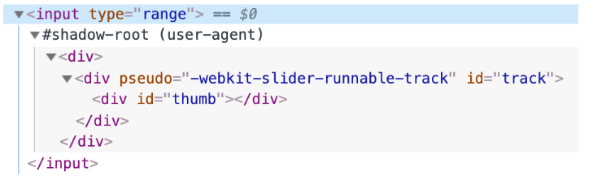
Handling Shadow DOM in Selenium
Shadow DOM is a web standard that allows developers to encapsulate HTML, CSS, and JavaScript inside a component.
It creates a separate DOM tree (called a shadow tree) that is isolated from the main document DOM
Commonly used in Web Components like <video>, <input>, or custom elements

Slide 87
How to Handle Shadow DOM
Method 1: Using getShadowRoot() (Selenium 4+)
WebElement shadowHost = driver.findElement(By.cssSelector("#shadow-host"));
SearchContext shadowRoot = shadowHost.getShadowRoot();
WebElement shadowElement = shadowRoot.findElement(By.cssSelector("#shadow-content"));
shadowElement.click();

Slide 88
Method 2: Using JavascriptExecutor (Legacy or Nested Shadow DOM)
JavascriptExecutor js = (JavascriptExecutor) driver;
WebElement shadowHost = driver.findElement(By.cssSelector("#shadow-host"));
WebElement shadowRoot = (WebElement) js.executeScript("return arguments[0].shadowRoot", shadowHost);
WebElement shadowElement = shadowRoot.findElement(By.cssSelector("#shadow-content"));
shadowElement.click();

Slide 89
DesiredCapabilities in Selenium
A class in Selenium used to define browser-specific settings
Helps configure the test environment (browser name, version, platform)
Used in cross-browser testing, Selenium Grid, and Appium

Slide 90
Why we need DesiredCapabilities
Set browser preferences dynamically
Enable features like headless mode, SSL certificate handling, etc.
Required for remote execution (e.g., Selenium Grid, cloud platforms)
Customize behavior for mobile devices in Appium

Slide 91
Properties in DesiredCapabilities
Capability | Description
browserName | Name of the browser (e.g., Chrome, Firefox)
version | Browser version
platform | OS platform (Windows, Linux, etc.)
acceptSslCerts | Accept insecure SSL certificates
headless | Run browser in headless mode
deviceName | Mobile device name (Appium)

Slide 92

Options Class in Selenium
Options classes allow you to configure browser-specific settings
Replaces DesiredCapabilities in Selenium 4
Used to set arguments, preferences, extensions, and capabilities
Examples: ChromeOptions, FirefoxOptions, EdgeOptions
Why use options:
  Launch browser in headless or incognito mode
  Disable extensions or pop-ups
  Set download paths or proxy settings
  Add custom capabilities for Selenium Grid or cloud platforms

Slide 93
Common Arguments in Options
Argument | Description
--headless | Run browser without GUI
--incognito | Launch in private mode
--start-maximized | Open browser in full screen
--disable-extensions | Disable installed extensions
--disable-popup-blocking | Prevent pop-up blocking

Slide 94
Option Type | Option Name / Method | Description
Browser Arguments | addArguments("--headless") | Launch browser in headless mode (no GUI)
 | addArguments("--incognito") | Open browser in incognito/private mode
 | addArguments("--start-maximized") | Start browser maximized
 | addArguments("--disable-extensions") | Disable all browser extensions
 | addArguments("--disable-popup-blocking") | Prevent pop-up blocking
 | addArguments("--remote-allow-origins=*") | Allow remote origins (useful for ChromeDriver v111+)
Preferences | setExperimentalOption("prefs", prefsMap) | Set browser preferences like download path, notification settings
Extensions | addExtensions(File) | Add browser extensions
Binary Path | setBinary("/path/to/browser") | Specify custom browser binary location
Capabilities | setCapability(key, value) | Add custom capabilities (e.g., proxy, SSL certs)
Page Load Strategy | setPageLoadStrategy(PageLoadStrategy.EAGER) | Control how long WebDriver waits for page load
SSL Certificates | setAcceptInsecureCerts(true) | Accept invalid or self-signed SSL certificates
Unhandled Prompts | setUnhandledPromptBehaviour(...) | Define behavior for unexpected alerts (dismiss, accept, etc.)
Timeouts | setImplicitWaitTimeout(Duration) | Set implicit wait timeout
 | setPageLoadTimeout(Duration) | Set page load timeout
 | setScriptTimeout(Duration) | Set timeout for executing scripts
Platform Name | setPlatformName("Windows") | Specify OS platform (useful for remote execution)
Browser Version | setBrowserVersion("latest") | Specify browser version
Window Rect Support | setCapability("setWindowRect", true) | Enable window resizing and positioning
File Interactability | setCapability("strictFileInteractability", true) | Enable strict checks for file input elements
Proxy Settings | setCapability("proxy", proxyObject) | Configure proxy server

Slide 95
Selenium 3 vs Selenium 4
Feature | DesiredCapabilities | Options Class
Deprecated in Selenium 4 | ✅ Yes | ❌ No
Browser-specific config | ✅ Limited | ✅ Recommended
Merge with Options | ✅ Supported | ✅ Supported

